Slide 1
Introduction to WEB DESIGNING
By
Neha More
Lecturer in IT
SBMP

Slide 2
Internet Related Terminology:
Internet
The Internet is a vast network that connects computers all over the world. Through the Internet, people can share information and communicate from anywhere with an Internet connection.
Web Page:
A web page (such as the one you are looking at now) is an electronic document written in a computer language called HTML (Hypertext Markup Language).
Web pages can contain text, graphics, video, animation, and sound, as well as interactive features, such as data entry forms.
Website:
A website (often shortened to just site) is one or more web pages, belonging to a particular company, institute, government or an individual.
Protocol:
It is a set of rules or procedures for transmitting data between electronic devices, such as computers.
Hypertext Transfer Protocol (HTTP)
The abbreviation for Hypertext Transfer Protocol. It is the set of rules by which Web pages are transferred across the Internet.
Internet Protocol (IP) Address
Each computer on the Internet can be identified by a set of unique numbers that is called an internet protocol (IP) address. The IP address is composed of four different numbers separated by periods such as 205.134.120.60.

Slide 3
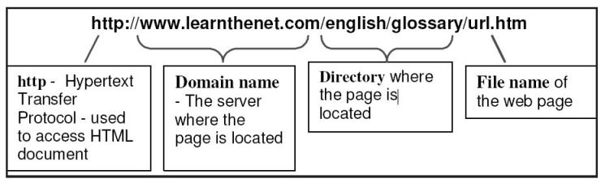
URL(Uniform Resource Locator):
Every page on the web has a unique address, called Uniform Resource Locator, URL. A URL indicates where the web page is stored on the Internet. A sample
URL might look like the following:
Client:
A client is a computer hardware device or software that accesses a service made available by a server. The server is often (but not always) located on a separate physical computer.
Server:
A server is a physical computer dedicated to run services to serve the needs of other computers. Depending on the service that is running, it could be a file server, database server, home media server, print server, or web server.

Slide 4
Web Server:
A Web Server is a computer that stores web pages. It is responsible for accepting request(s) from users and serves them with web pages.
Domain
While every computer has its own unique address, every user using the Internet has a unique address called a domain. A domain recognizes one or more IP addresses. An example of a domain is weather.com and is part of the URL such as https://www.weather.com.
The standard top-level domains are:
com - Commercial business
edu - Educational institutions
gov - Government agencies
mil - Military
net - Networks organization
org - Organizations (nonprofit)

Slide 5
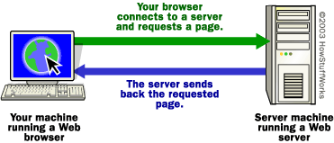
Web server:
It is a software that delivers Web pages and other documents to browsers using the HTTP protocol from the computer on which such software runs.
For Example : you are sitting at your computer, surfing the Web using a browser, Typing this URL and check it out. It's at http://www.abcxyz.com/def.htm."
So you type that URL into your browser and press Enter, no matter where in the world that URL lives, the page pops up on your screen.

Slide 6
The basic steps that occurred behind the scenes:
The browser broke the URL into three parts:
The protocol ("http")
The server name ("www.abcxyz.com”)
The file name ("def.htm")
The browser communicated with a name server(Domain Name Server) to translate the server name "www.abcxyz.com" into an IP Address, which it uses to connect to the server machine.
The browser then formed a connection to the server at that IP address on port 80.
Following the HTTP protocol, the browser sent a GET request to the server, asking for the file http://www.abcxyz.com/def.htm.
The server then sent the HTML text for the Web page to the browser.
The browser read the HTML tags and formatted the page onto your screen.
Note:The services and its port numbers are used to differentiate between various services that execute over transport protocols such as TCP/IP, UDP, DCCP, and SCTP.
Ports are software-based and managed by a computer's operating system. Each port is associated with a specific process or service.

Slide 7
Service Name | Port Number
FTP | 20, 21
SSH | 22
Telnet | 23
SMTP | 25
DNS | 53
DHCP | 67, 68
TFTP | 69
HTTP | 80
POP3 | 110
NNTP | 119
NTP | 123
IMAP4 | 143
LDAP | 389
HTTPS | 443
IMAPS | 993
RADIUS | 1812
AIM | 5190

Slide 8
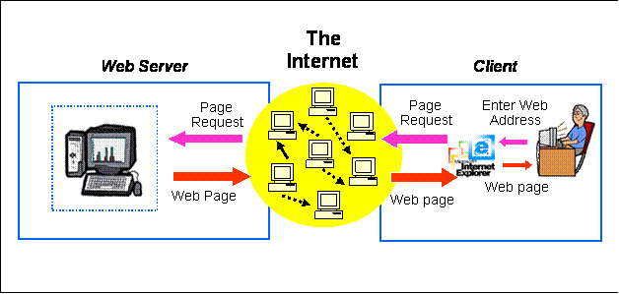

Slide 9
Client-Server Model
In the client-server architecture, when the client computer sends a request for data to the server through the internet, the server accepts the requested process and deliver the data packets requested back to the client.
How the Client-Server Model works ?
Client:
When we talk the word Client, it mean to talk of a person or an organization using a particular service. Similarly in the digital world a Client is a computer (Host) i.e. capable of receiving information or using a particular service from the service providers (Servers).
Servers:
Similarly, when we talk the word Servers, It mean a person or medium that serves something. Similarly in this digital world a Server is a remote computer which provides information (data) or access to particular services.
Note The Client requesting something and the Server serving it as long as its present in the database.

Slide 10
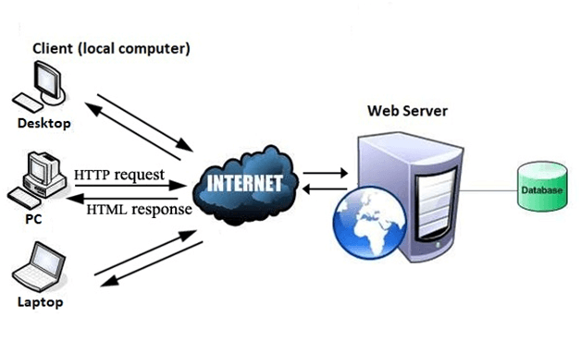
How the browser interacts with the servers ?

Slide 11
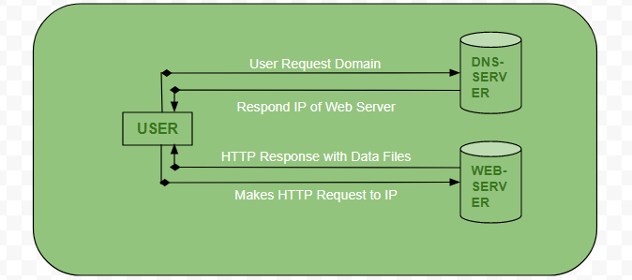
How the browser interacts with the servers ?
User enters the URL(Uniform Resource Locator) of the website or file. The Browser then requests the DNS(DOMAIN NAME SYSTEM) Server.
DNS Server lookup for the address of the WEB Server.
DNS Server responds with the IP address of the WEB Server.
Browser sends over an HTTP/HTTPS request to WEB Server’s IP (provided by DNS server).

Slide 12
How the browser interacts with the servers ?
Server sends over the necessary files of the website.
Browser then renders the files and the website is displayed. This rendering is done with the help of DOM (Document Object Model) interpreter, CSS interpreter and JS Engine collectively known as the JIT or (Just in Time) Compilers.

Slide 13
Advantages of Client-Server model:
Centralized system with all data in a single place.
Cost efficient requires less maintenance cost and Data recovery is possible.
The capacity of the Client and Servers can be changed separately.
Disadvantages of Client-Server model:
Clients are prone to viruses, Trojans and worms if present in the Server or uploaded into the Server.
Server are prone to Denial of Service (DOS) attacks.
Data packets may be spoofed or modified during transmission.
Phishing or capturing login credentials or other useful information of the user are common and MITM(Man in the Middle) attacks are common.

Slide 14
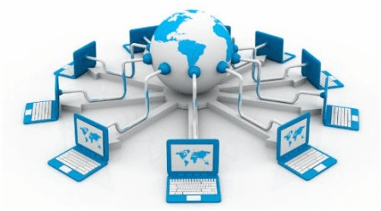
What is World Wide Web?
World Wide Web, which is also known as a Web, is a collection of websites or web pages stored in web servers and connected to local computers through the internet.
These websites contain text pages, digital images, audios, videos, etc.
Users can access the content of these sites from any part of the world over the internet using their devices such as computers, laptops, cell phones, etc.
The WWW, along with internet, enables the retrieval and display of text and media to your device.

Slide 15
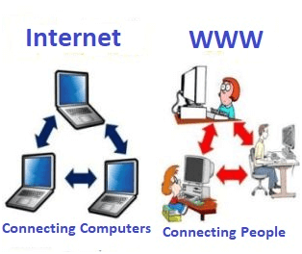
Difference between World Wide Web and Internet:
people use the terms 'internet' and 'World Wide Web' interchangeably, but it is different
when you send an email or chatting with someone online, you are using the internet.
when you have opened a website like google.com for information, you are using the World Wide Web; a network of servers over the internet.

Slide 16
Types of SERVER
Application Server: It share the territory between database servers and end users.(Connects database with web servers.)
Audio and Video Server: It provides multimedia capabilities to websites to broadcast streaming of user’s multimedia content.
Mail Server: It transfers and stores the emails over corporate networks through LANs, WANs and across the Internet.
FTP Servers: File Transfer Protocol makes it possible to move one or more files securely between computers.
Fax Servers:organizations can fax large amount of documents.
Chat Servers: They enable users to exchange information in an environment that offer real-time discussion capabilities. A simple server that distributes any incoming messages to all connected clients.

Slide 17
ISP:
Stands for "Internet Service Provider."
An ISP provides access to the Internet.
Whether you're at home or work, each time you connect to the Internet, your connection is routed through an ISP.
How ISP works??
Early ISPs provided Internet access through dial-up modems.
This type of connection took place over regular phone lines and was limited to 56 Kbps.
In the late 1990s, ISPs began offering faster broadband Internet access via DSL and cable modems.
Some ISPs now offer high-speed fibre connections, which provide Internet access through fibre optic cables.
Companies like Comcast and Time Warner provide cable connections while companies like AT&T and Verizon provide DSL Internet access.

Slide 18
To connect to an ISP, you need a modem and an active account.
When you connect a modem to the telephone or cable outlet in your house, it communicates with your ISP.
The ISP verifies your account and assigns your modem an IP address. Once you have an IP address, you are connected to the Internet.
You can use a router (which may a separate device or built into the modem) to connect multiple devices to the Internet.
Since each device is routed through the same modem, they will all share the same public IP address assigned by the ISP.
ISPs act as hubs on the Internet since they are often connected directly to the Internet backbone.
Because of the large amount of traffic ISPs handle, they require high bandwidth connections to the Internet.
In order to offer faster speeds to customers, ISPs must add more bandwidth to their backbone connection in order to prevent bottlenecks.
This can be done by upgrading existing lines or adding new ones.

Slide 19
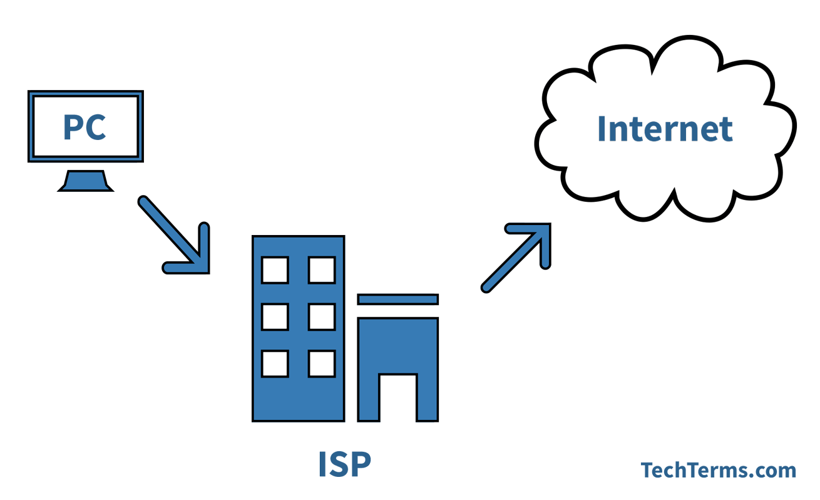
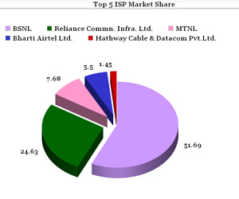

Slide 20
scripting language
A scripting language is used to write scripts. These contain a series of commands that are interpreted one by one at runtime unlike programming languages that are compiled first before running.
NOTE:A script is a program or sequence of instructions that is interpreted or carried out by another program rather than by the computer processor
Nowadays, scripts are generally associated with web development where they are widely used to make dynamic web applications. Scripting languages can be divided into two categories:
Server Side Scripting Languages
Client Side Scripting Languages

Slide 21
Server-side Scripting
Server-side scripting is a technique used in website designing to create dynamic web pages based on various conditions when the user’s (client’s) browser makes a request to the server The Web Server executes the server-side scripting which produces the page to be sent to the browser. The server executes server-side scripts to forward a page however it doesn’t execute client-side scripts.
Server-side scripting is often used to connect with the databases that locate on the web server. Also, it can approach the file system lying at the web server. It is generally observed that response from a server-side script is slower when compared to a client-side script as the scripts are prepared on the seclude computer.
Examples of Server-side Scripting
PHP
ASP
JSP
Python
Pearl
Ruby
Node.js
Cold Fusion Markup Language- CFML

Slide 22
Client-side Scripting
Client-side Scripting is utilized when the client’s (user’s) browser has all the code and the page is modified on the basis of the client’s (user’s) information. The Web Browser executes the client-side scripting that locates within the user’s computer. Client-side scripts are also known as the embedded script (as they are often embedded within an HTML or XHTML document).
Examples of Popular Client-side Scripting
JavaScript
ActionScript
VBScript (can be used on serverside also)
Dart
TypeScript
Python

Slide 23
Markup Language
A markup language is a computer language that uses tags to define elements within a document.
It is human-readable, meaning markup files contain standard words, rather than typical programming syntax.
While several markup languages exist, the two most popular are HTML and XML.
HTML is a markup language used for creating webpages.
The contents of each webpage are defined by HTML tags. Basic page tags, such as <head>, <body>, and <div> define sections of the page, while tags such as <table>, <form>, <image>, and <a> define elements within the page. Most elements require a beginning and end tag, with the content placed between the tags.

Slide 24
PRINCIPLES OF GOOD WEBSITE DESIGN:
An effective website design should fulfill its intended function by conveying its particular message whilst simultaneously engaging the visitor. Several factors such as consistency, colours, typography, imagery, simplicity and functionality all contribute to good website design.
1. WEBSITE PURPOSE
Your website needs to accommodate the needs of the user. Having a simple clear intention on all pages will help the user interact with what you have to offer. What is the purpose of your website? Are you imparting practical information like a ‘How to guide’? Is it an entertainment website like sports coverage or are you selling a product to the user? There are many different purposes that websites may have.

Slide 25
2. SIMPLICITY:
Simplicity is the best way to go when considering the user experience and the usability of your website. Below are ways to achieve simplicity through design.
Color
Colour has the power to communicate messages and evoke emotional responses. Finding a colour palette that fits your brand will allow you to influence your customer’s behaviour towards your brand. Keep the colour selection limited to less than 5 colours. Complementary colours work very well. Pleasing colour combinations increase customer engagement and make the user feel good.
Type
Typography has an important role to play on your website. It commands attention and works as the visual interpretation of the brands voice. Typefaces should be legible and only use a maximum of 3 different fonts on the website.
Imagery
Imagery is every visual aspect used within communications. This includes still photography, illustration, video and all forms of graphics. All imagery should be expressive and capture the spirit of the company and act as the embodiment of their brand personality. Most of the initial information we consume on websites is visual and as a first impression it is important that high quality images are used to form an impression of professionalism and credibility in the visitors mind.

Slide 26
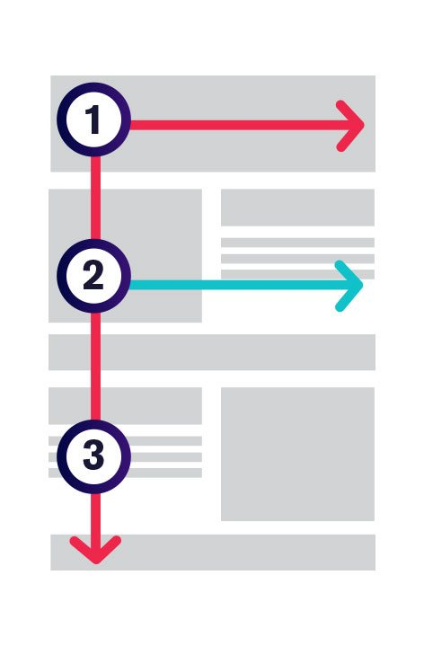
3. NAVIGATION
Navigation is the way finding system used on websites where visitors interact and find what they are looking for. Website navigation is key to retaining visitors. If the websites navigation is confusing visitors will give up and find what they need elsewhere. Keeping navigation simple, intuitive and consistent on every page is key.
4. F-SHAPED PATTERN READING
The F- based pattern is the most common way visitors scan text on a website. Eye tracking studies have found that most of what people see is in the top and left area of the screen. The F’ shaped layout mimics our natural pattern of reading in the West (left to right and top to bottom). An effective designed website will work with a readers natural pattern of scanning the page.

Slide 27
5. VISUAL HIERARCHY
Visual hierarchy is the arrangement of elements is order of importance. This is done either by size, colour, imagery, contrast, typographically, whitespace, texture and style. One of the most important functions of visual hierarchy is to establish a focal point; this shows visitors where the most important information is.
6. CONTENT
An effective web design has both great design and great content. Using compelling language great content can attract and influence visitors by converting them into customers.
7. GRID BASED LAYOUT
Grids help to structure your design and keep your content organized. The grid helps to align elements on the page and keep it clean. The grid based layout arranges content into a clean rigid grid structure with columns, sections that line up and feel balanced and impose order and results in an aesthetically pleasing website.
8. LOAD TIME
Waiting for a website to load will lose visitors. Nearly half of web visitors expect a site to load in 2 seconds or less and they will potentially leave a site that isn’t loaded within 3 seconds. Optimising image sizes will help load your site faster.

Slide 28
9. MOBILE FRIENDLY:
More people are using their phones or other devices to browse the web. It is important to consider building your website with a responsive layout where your website can adjust to different screens.

Slide 29
Process of wesite designing
There are seven steps that should be followed from start to finish when developing a website.
Research and goal setting
Planning
Designing the layout
Writing the content
Coding
Testing and launching
Maintaining

Slide 30
Website Development Planning Process:
1. RESEARCH AND GOAL SETTING
As with any project, it is important to do proper research and set goals before beginning.
By setting goals, it will help the website to have a direction and will also help your business to achieve specific accomplishments.
The planning and goal setting process could take about 1-2 weeks to complete.
There are a few questions you should ask yourself during this phase:
What do I hope for my website to accomplish?
Who is the audience I would like to target?
What are the main goals of the website?
By setting goals for your website, you will be helping the site to have a clear direction and purpose.
This can help you to determine what you want and don’t want your website to have. It is also important to do some research on the target audience you hope to draw in.

Slide 31
2. PLANNING THE SITE:
Planning the website involves creating a sitemap.
This is an important step because it is kind of like the skeleton of your site.
This process can take about 2-6 weeks to complete.
The sitemap allows the developer to get an outline of what the site will look like, what pages there will be and how they will interact with each other. This not only helps with planning but is also beneficial to the user experience.
A user should be able to easily navigate a site, and this begins with the development of the sitemap.
Before you begin to plan content, a sitemap lets you design what the structure will look like.
Once the sitemap is completed, the other part of this step is to create a wireframe or mock-up.
s
These are just visual representations of what the site will look like.

Slide 32
3. DESIGNING THE LAYOUT:
The details of the layout are what will give your website character.
This is the step where you get to be creative with pictures, videos and what kinds of things the customer will notice when they come to your site.
This process can take about 4-12 weeks from start to finish.
During this step, it is especially important to keep referring back to the target audience you wish to focus on.
Consider colors, logos, and anything that will encourage your audience to interact with the site.

Slide 33
4. WRITING THE CONTENT:
This step may be going on simultaneously with the other development planning steps.
The written content of a website is so important to its success. While this step may be happening during other steps, it is one that is crucial and deserves a lot of expertise.
It could take from 5 to 15 weeks.
There is a lot to consider when working on the content of the website.
When determining what words to use, it is important that they are not too hard to understand.
A general rule is that you have to assume not everyone is going to want to read words that are higher vocabulary. A website should have a vocabulary that the average person can understand.

Slide 34
5. CODING THE WEBSITE:
Now that all aspects of your website have been created, you are ready to actually begin creating the website itself.
The coding typically begins with the homepage and gradually branches out to the other pages included in the site.
This would be where the sitemap is followed to ensure everything is coded correctly.
The coding step could take from 6 to 15 weeks, depending on how much content and how intricate you would like your website to be.
It is also important to set up frameworks and CMS to make sure that everything will fit onto the server during the installation process.
Once the website is laid out according to the sitemap, it should be tested before moving any further. If all works well, then the rest of the content should be added, and formatting should be completed.

Slide 35
6. TESTING AND LAUNCHING:
Before the website is launched, it is crucial that it is tested out by real users.
All the links and content should be tested to see if it works.
Not only is it important to test out all the buttons and everything on the site, but it is also important to test out what users think of it.
There is user testing that can be completed to make sure the website is giving users what they need to be successful on the test.

Slide 36
7. MAINTENANCE:
You might think your job is done once the website is launched, but this is not the case.
Since technology and products are changing more rapidly than ever before, it is important to stay up-to-date with what is happening on the internet.
Maintaining a website is hard work, but the more effort put into its maintenance, the better.
For one, it should constantly be checked out for errors.
When a user encounters an error, this may be frustrating and may cause them to find what they are looking for somewhere else.
Errors can also completely block them from the information they need to make a decision on purchasing a product or service.
This is why it is important to not only test your website for user experience before the launch, but after as well.

Slide 37
Web Design
10 Rules of Web Design
Keep it simple.
Cramming too much into each page creates confusion. Visitors get frustrated when they have to scroll through a cluttered interface to find what they need.
Keep your pages simple and your website will be easier to use.
Make a good impression.
When you meet someone for the first time, you want to make a good first impression. The same should be true for your website.
The overall look and feel of your site is the first thing your visitors will notice.
Provide intuitive navigation.
Sections and pages should be well-organized with a top-down design so visitors can easily browse through the different areas of your site.
Be consistent.
Users shouldn't feel like they are visiting a new website each time they open a new page on your site.
A consistent layout and design across the pages within your site provides a more natural experience.
Choose your colors carefully.
Color selection can make or break a website. When choosing colors, use a limited palette of four or five colors that don't clash.
Make sure the text is easy to read on the background, though you can soften the contrast with colors besides black and white.

Slide 38
Make your website responsive.
People access websites from a variety of devices, including smartphones, tablets, laptops, and desktop computers.
Your website must display correctly on different screen sizes. CSS media queries are a great way to implement responsive web design.
Develop for multiple browsers.
Test your website in multiple browsers to make sure everything appears correctly.
It is best to catch problems ahead of time instead of relying on complaints from your visitors.
Check your website for errors.
A small error can tarnish a great piece of work.
If you're a webmaster, check your websites regularly for typos, broken links, and images that do not load correctly. Validate your HTML and CSS to make sure there are no syntax errors.
Write your own code.
Whether it's HTML or PHP, nothing beats writing your code from scratch.
If you build your site from templates and pre-written scripts, your design freedom will be limited. When you code your own pages, you have full control over how they look and act.
Don't forget the content.
A beautiful website is an empty shell without content.
An excellent website has both great design and great content. Make sure your pages have unique, original content that makes them worth visiting.

Slide 39
Web Hosting:
What is Web Hosting?
Web hosting is a service that allows organizations and individuals to post a website or web page onto the Internet.
A web host, or web hosting service provider, is a business that provides the technologies and services needed for the website or webpage to be viewed in the Internet.
Websites are hosted, or stored, on special computers called servers.
When Internet users want to view your website, all they need to do is type your website address or domain into their browser.
Their computer will then connect to your server and your webpages will be delivered to them through the browser.

